Slide 1
Version and Transport management
Bangalore, Rajkumar

Slide 2
Table of Contents
Transport Management Overview
1
CTS+ Direct
1a
MTAR Download
1b
Transport Management Service
1c
Manual Export
1d
Version Management
2

Slide 3
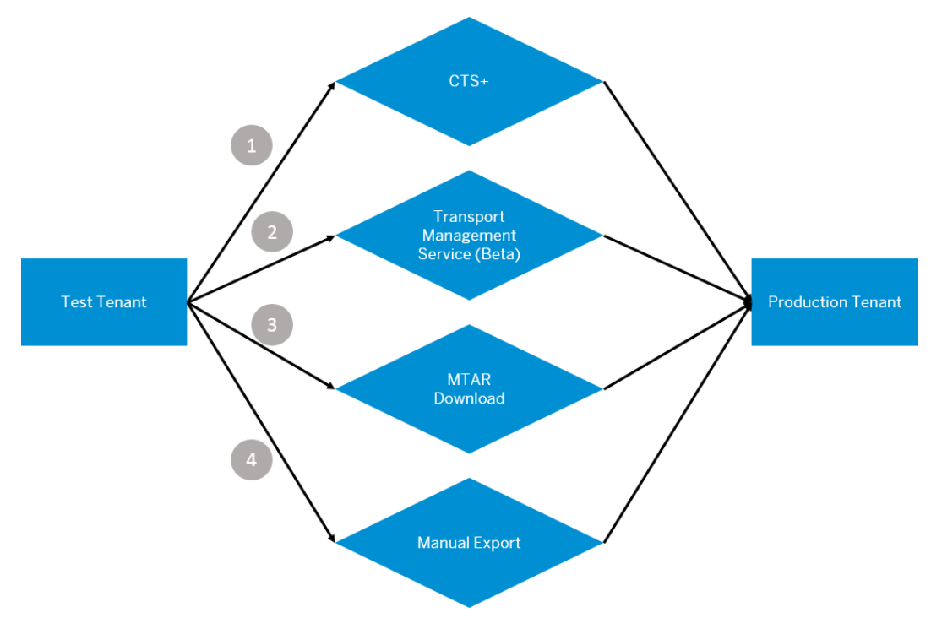
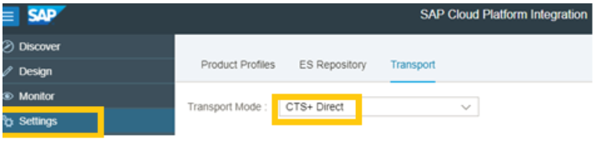
1.Transport Management Overview
Content Transport Management allows us to reuse content between multiple tenants by exporting it from one tenant and importing it on another.
All these process has prerequisites. These setup the background configuration of Transport systems to the CPI system
User needs IntegrationContent.Transport to Transport the components in CPI
Dropdown list provides the Transport modes supported

Slide 4
1a.CTS+ Direct
This transport feature enables us to transport the integration package from the Dev/Test to the production landscape via Change and Transport System CTS+.
Settings to be done to enable CTS+ based transport
You should enable transport to CTS+. As a Tenant Admin you can do this by accessing Settings Option and choosing the tab Transport Settings. You would have to choose either ‘MTAR Download’ or ‘CTS+ Direct’ from the dropdown list.
Enable the service, Solutions Lifecycle Management in your account. Ensure that you perform this step in all the accounts where you want to use content transport using CTS+. This is a one-time activity. You can do that by
Login to your account in the SAP Cloud Platform.
Choose Services Solutions Lifecycle Management .
Choose Enable.
Create a new HTTP destination by selecting Configure Destinations. Ensure that the Name of the destination is Cloud Integration (case-sensitive) and the URL is the URL of the tenant management node
https://blogs.sap.com/2018/04/10/content-transport-using-cts-cloud-integration-part-1/?preview_id=644115

Slide 5
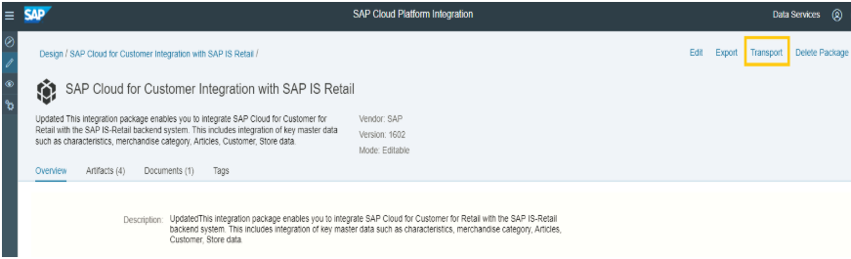
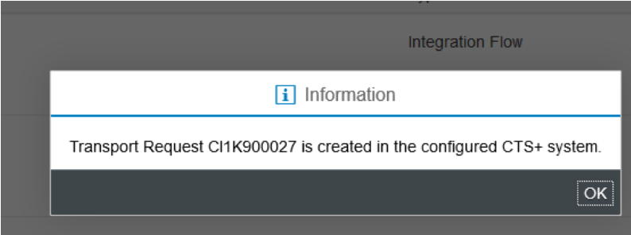
1a.CTS+ Direct
CTS+Direct would push MTAR content to an open Transport request in the configured CTS+ system maintained as a Destination.
In the Test/Source tenant, select the integration package that you want to transport.
Click on Transport.
In the Transport Comments prompt, provide comments and click on Transport.
Transport id will be displayed as shown above.

Slide 6
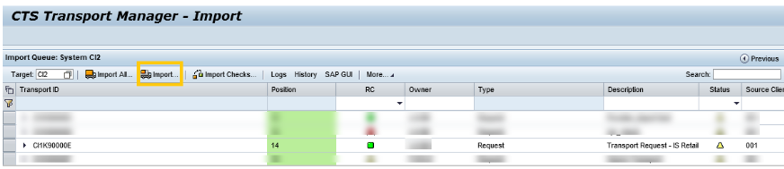
1a.CTS+ Direct
Navigate to target system and select the transport ID request and click on Import.
Confirm Import with Date: Immediate and Import Options as: Leave Transport Requests in Queue for Later Import.
The Integration package is imported into the Production tenant Account.
In case of errors, you can check the logs by selecting the Import request and clicking on Logs button.

Slide 7
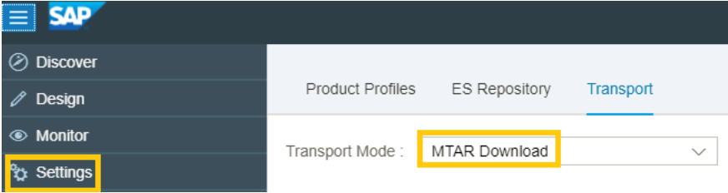
1b. MTAR Download
Transport Mode has to be set to MTAR Download in Settings tab of CPI.
In the Source/Test tenant, Select the integration package that you want to transport.
Click on Transport.
A file with extension .mtar is downloaded to your local file system in the download path configured in your browser.
Ensure that the Integration flows to be transported are not in Draft State.
CTS+ is used to transport applications that are downloaded as MTAR files. Multiple MTA archives can be deployed to your subaccount in one run.

Slide 8
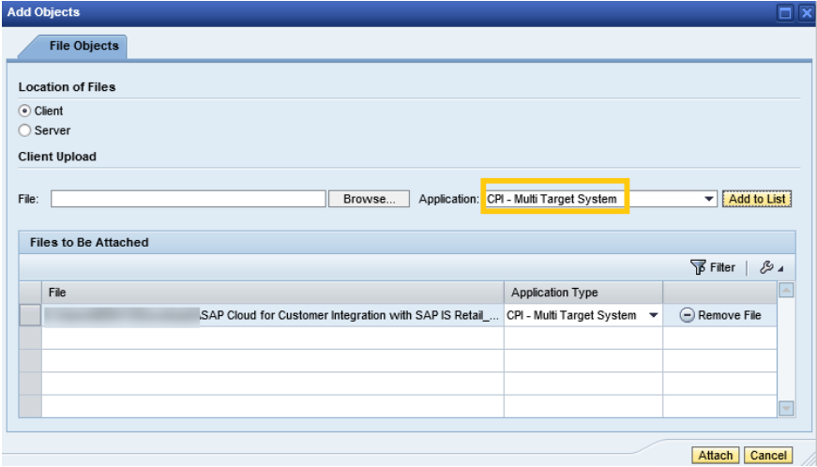
1b. MTAR Download
Steps needed in CTS+ Configuration:
Transport Source and Target system has to be set in CTS.
Login to the WebUI -> Transport Organizer
Click on Create Request – a pop up will open with the below details. Enter a and click on Create.
In Object List tab, Click on Attach and browse for the .mtar file from your local system.
Select the Application as “CPI – Multi Target Application” and click on “Add to List”.
Click on Attach. The transport request will be updated. Click on Save Changes in the Object list tab.
After you have added one or more MTA archives in the request. Click on Release.
Using CTS the released TR can be imported to the Target system.

Slide 9
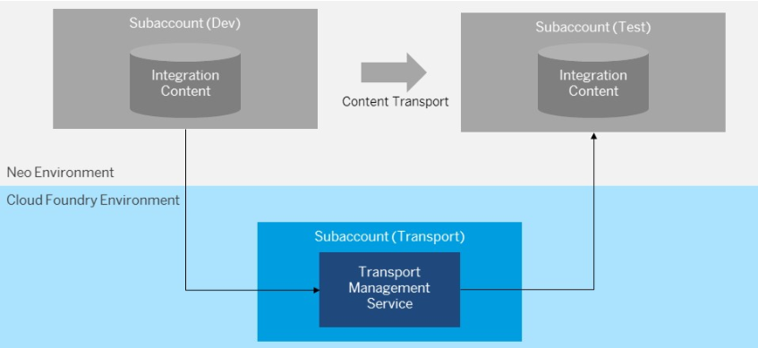
1c. Transport Management Service
Cloud Platform Integration customers can transport Integration Packages across Tenants using Cloud Based Transport Management Service.
SAP Cloud Platform Transport Management runs in SAP Cloud Platform Cloud Foundry Environment
The files can be transported in one of the following scenarios:
Directly from within another application
They are available on local file systems
Steps needed can be referenced from the below link: https://blogs.sap.com/2018/04/23/getting-started-with-sap-transport-management-service-beta-for-sap-cloud-platform/

Slide 10
1d. Manual Export
Manual Exports allows us to export the integration package to your local file system in the form of a .zip file.
You can import the same file in the target tenant using the Import option.
Procedure
Select the integration package that you want to export.
Choose Export.
A .zip file is downloaded to the default browser download location on your local file system.
Log in to the SAP Cloud Platform Integration web application to which you want to import the content. Choose
Choose Import.
A new window opens in your file system explorer, allowing you to access your local file system.
Navigate to the folder path where the .zip file was downloaded in step 3.
Select the file and choose Open.
You see a prompt indicating the successful import of the .zip file. You can see the imported integration package in the Design tab of your target tenant.

Slide 11
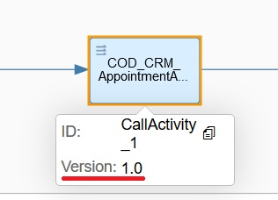

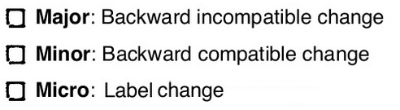
2.Version Management
Versioning is the creation and management of multiple releases of a software/component, all of which have the same general function but are improved, upgraded or customized.
In SAP Cloud Platform Integration, new version is created when a component, which is already shipped and is being used by the customers needs to be improved or updated.
New features are offered via the minor version updates and small fixes like label changes or UI alignments are offered via micro version updates.
Each component in SAP Cloud Platform Integration has a version and this version is defined using the paradigm <major>.<minor>.<micro>
Details of the micro versions are not shown in the design time, as these changes doesn’t affect the scenario and are auto migrated after every software update.

Slide 12


